Slide 1
Term Project US Airline Flights & Fares
By Debbie McMurrick
DSC 530 Data Exploration and Analysis
November 16, 2024

Slide 2
Dataset Information
Dataset: US Airline Flights & Fares 1993 – 2024
This dataset covers airline flight routes, fares, and passenger volumes within the United States from 1993 to 2024.
It includes metrics like airport distances, passenger numbers, and fare data by airline carriers.
The goal of this project is to predict average fares on specific routes, offering valuable insights into airline pricing strategies and passenger behavior.

Slide 3

Statistical Question
Question:
What variables impact finding the lowest fare for an airline ticket?

Slide 4
Variables for Analysis
This analysis will focus on 6 variables:
Year: Year of the data record
fare: Average fare
fare_low: Lowest fare *** trying to predict this!
fare_lg: Average fare of the largest carrier
nsmiles: Distance between airports in miles
passengers: Number of passengers

Slide 5
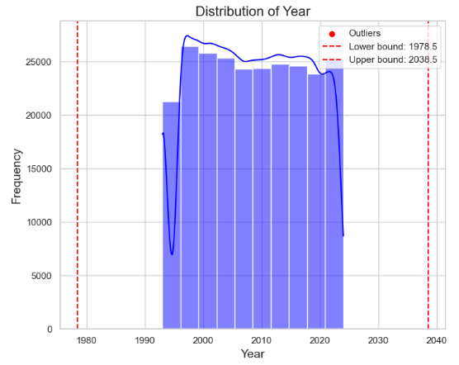
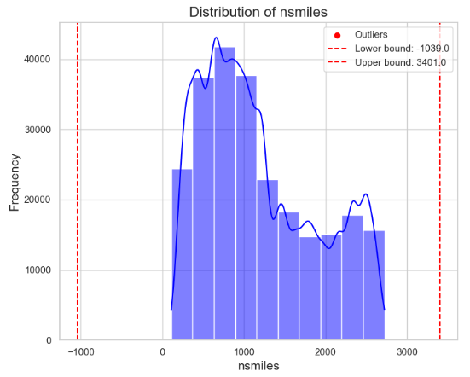
Histogram of ‘Year’ & ‘nsmiles’
The ‘Year’ variable shows:
No outliers
The ‘nsmiles’ or Distance Between Airports variable shows:
No outliers

Slide 6
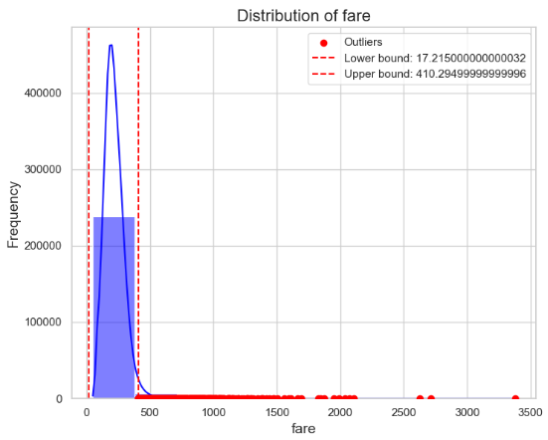
Histogram of ‘fare’
The ‘fare’ variable shows:
4,757 outliers
These fall above the upper bound of $410.295
Highest outlier is > $3,000
This shows there is some variability in fare that could be due to:
Pricing errors
Market variability
I’m not going to remove outliers
Need more info to determine if needed
This could also remove needed fare_low data
Some data was adjusted for accuracy purposes, and they are noted in the slides.

Slide 7
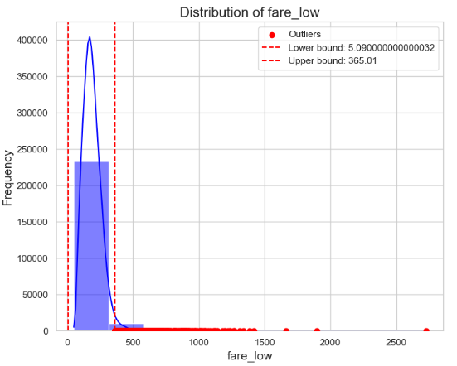
Histogram of ‘fare_low’
The ‘fare_low’ variable shows:
4,685 outliers
These fall above the upper bound of $365.01
Highest outlier is > $2,500
This also shows there is some variability in fare that could be due to:
Pricing errors
Market variability
I’m not going to remove the outliers

Slide 8
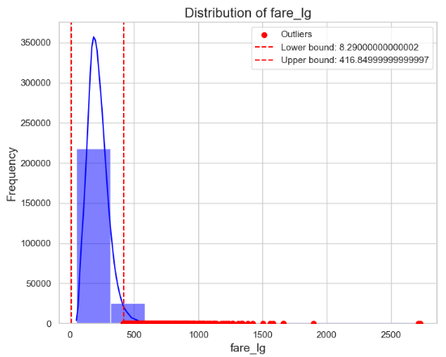
Histogram of ‘fare_lg’
The ‘fare_lg’ variable shows:
5,337 outliers
These fall above the upper bound of $416.85
Highest outlier is > $2,500
This also shows there is some variability in the highest fares
The outliers will not be removed

Slide 9
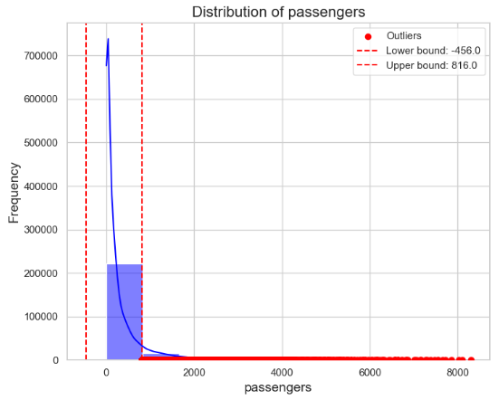
Histogram of ‘passengers’
The ‘passengers’ variable shows:
24,480 outliers
These fall above the upper bound of 816
Highest outlier is > 8,000
Data shows higher passenger counts but I’m not sure these were entered correctly
The Outliers will not be removed

Slide 10
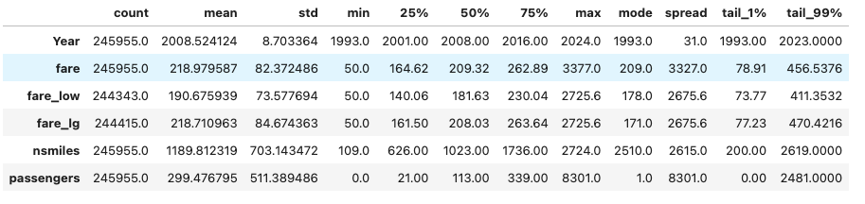
Descriptive Characteristics
Mean: average value of each field.
STD: measures he dispersion/spread of a set of values in a dataset.
Mode: returns the most frequent value of reach field.
Spread (range): the difference between the maximum and minimum values
Tails: 1% and 99%: the first and 99th percentiles, or “tails” of the distribution

Slide 11
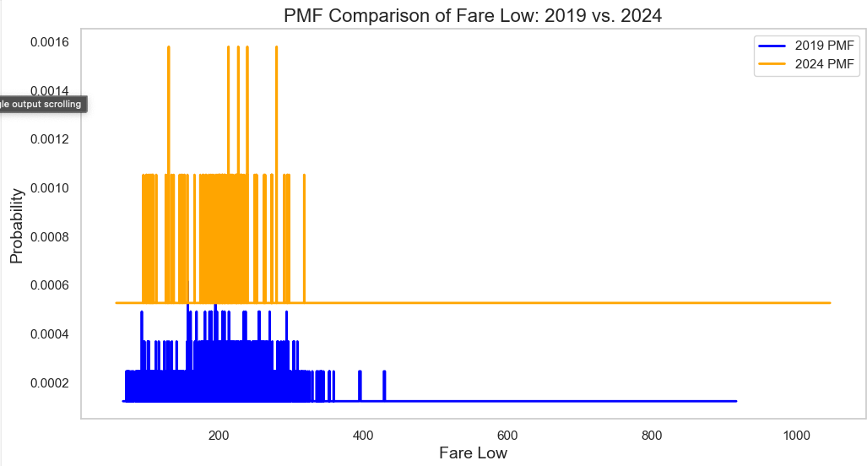
PMF Comparison: 2019 vs 2024
Probability Mass Function (PMF) is another way to represent a distribution
Maps each value to its probability of occurrence
Comparing 2019 to 2024, shows us:
2024 has a higher probability to have low fares around the $200s
2019 has a lower probability with the fares spread from $100-300

Slide 12
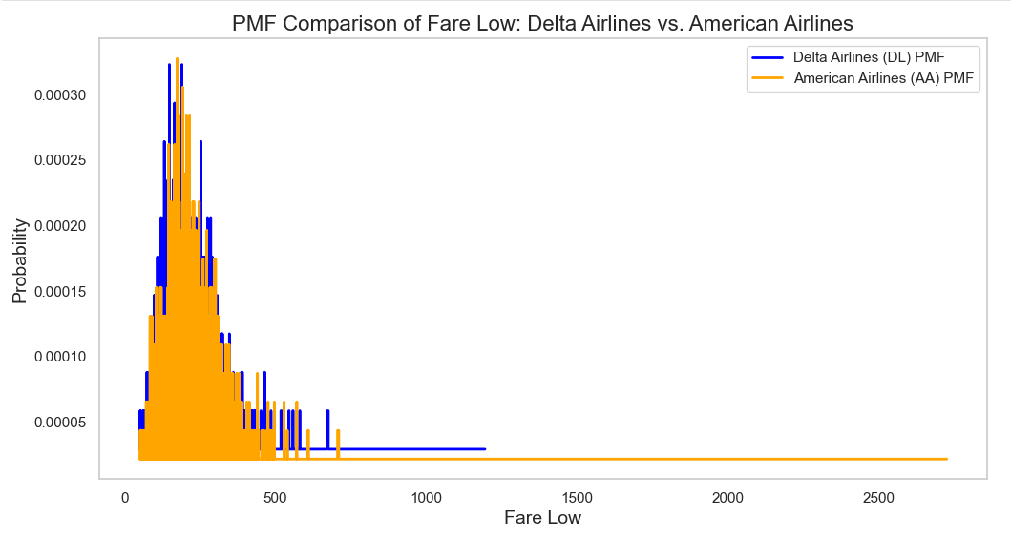
PMF Comparison: Delta vs. American
Comparing Delta vs. American Airlines shows:
The lowest fares are very similar when comparing the two airlines
Both airlines appear to have a median low fare of roughly $250.

Slide 13
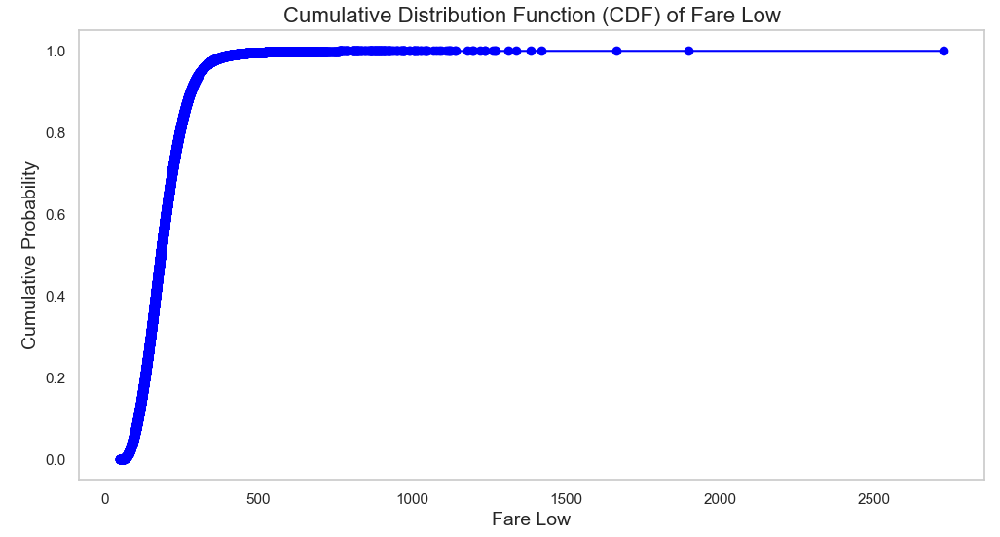
CDF Comparison
Cumulative Distribution Function (CDF)
Maps a value to its percentile rank
Visual representation of the shape of the distribution and how fares accumulate
CDF of fare_low
With NaN values removed for accurate CDF
Findings:
Most low fares are below ~$400
Larger fares are seen at the top but are not not a common occurrence

Slide 14
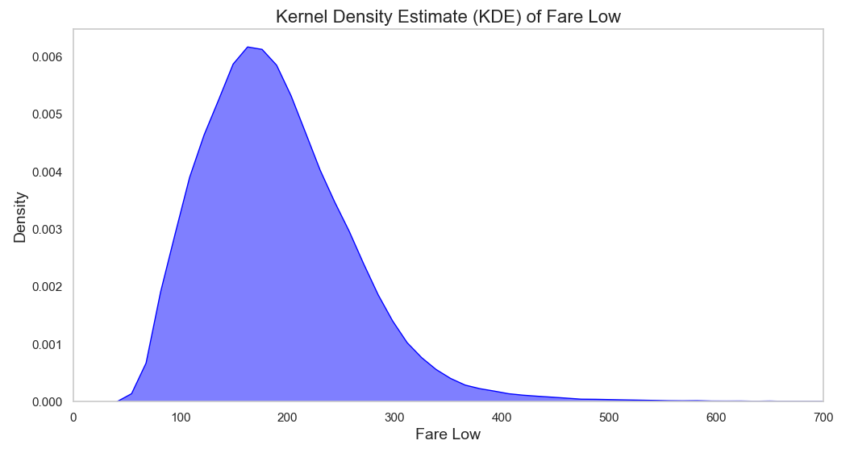
Analytical Distribution
Kernel Density Estimate (KDE)
Plots a smooth curve that represents the probability density of the lowest fare price
Peak ~$180 indicate the most common lowest fare.
Allows for deeper understanding of fare distribution
Skews to left, suggests that most fares are lower, but there are some high priced outliers.

Slide 15
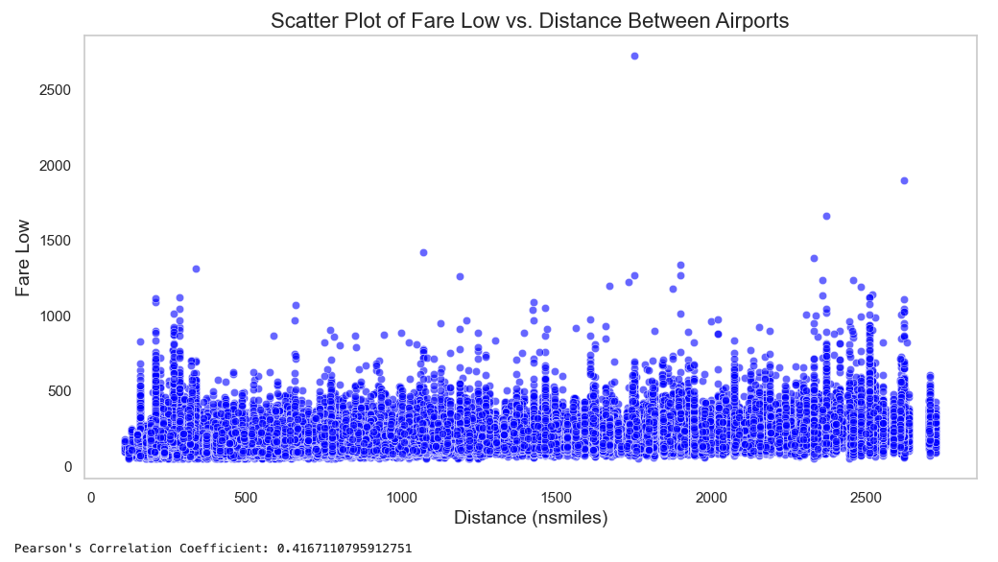
Scatter Plot Comparing Low Fare to Distance between Airports
Pearson’s Correlation Coefficient = 0.417
Indicates a moderate, positive linear correlation because it’s closer to 1
It is significant
Positive correlation means as one distance increase, low fare also increase
Does not imply causation – other factors could influence it
Correlation and Causation Analysis
Straight line relationship suggests a strong, predictable linear correlation between these two variables.
Other factors could influence low fares.
Airline pricing strategies
Market competition
Demand elasticity

Slide 16
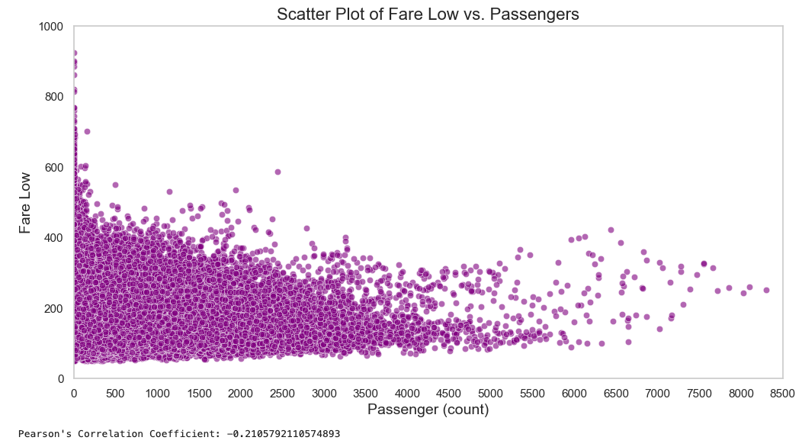
Scatter Plot Comparing Low Fare to Number of Passengers
Pearson’s Correlation Coefficient = -0.2106
Indicates a weak, negative linear relationship between these two variables
Other factors influence Low Fare and Passenger counts
Dropped NaN values and set passengers > 0
Correlation and Causation Analysis
Graph shows a curved line, indicates linear relationship
Relationship between variables varies at different levels
This relationship may be coincidental and influenced by a third factor or just weak.

Slide 17
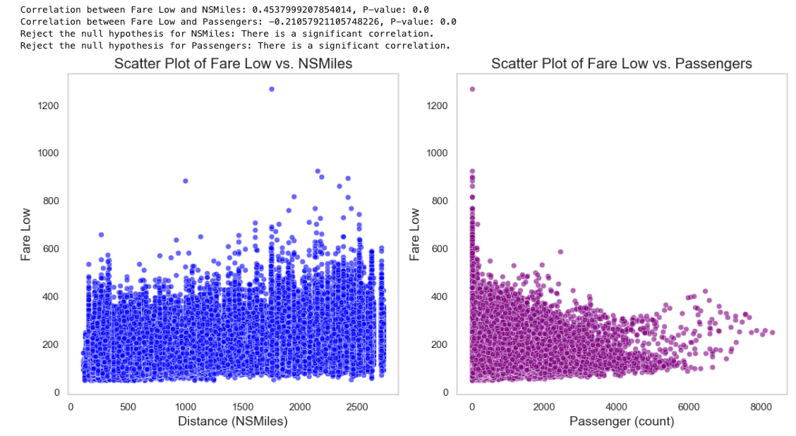
Test the Hypothesis Results
Correlation between:
Dopped NaN values
Set nsmiles, fare_low, passengers > 0
Significance level = 0.5
Fare Low & Nsmiles
Correlation coefficient = 0.45
P-Value = 0.00
Fare Low & Passengers
Correlation coefficient = -0.21
P-Value = 0.00

Slide 18
Test the Hypothesis Analysis
Fare_Low and Nsmiles
Indicates a moderate positive correlation
As distance increases, fare prices tend to increase
This is expected as longer flights usually have higher costs
Fare_Low and Passengers
Indicates a weak negative correlation
As passenger counts increase, fare prices tend to decrease slightly.
Suggests flights with more passengers might offer lower rates
Outcome
We can confidently reject the null hypothesis for both scenarios

Slide 19
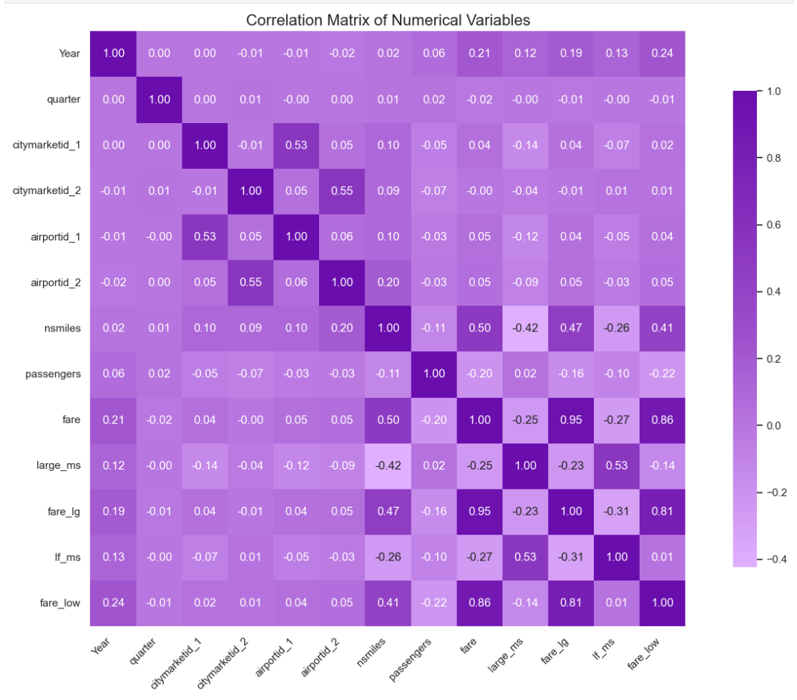
Correlation Matrix
Plot of correlation matrix
Shows the pairwise correlations between multiple variables
Helps understand strength and direction of relationships
Strong pairs to fare_low:
Nsmiles
Fare
Fare_lg
Year

Slide 20
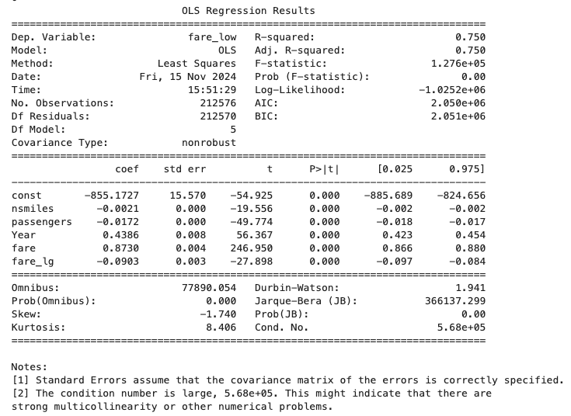
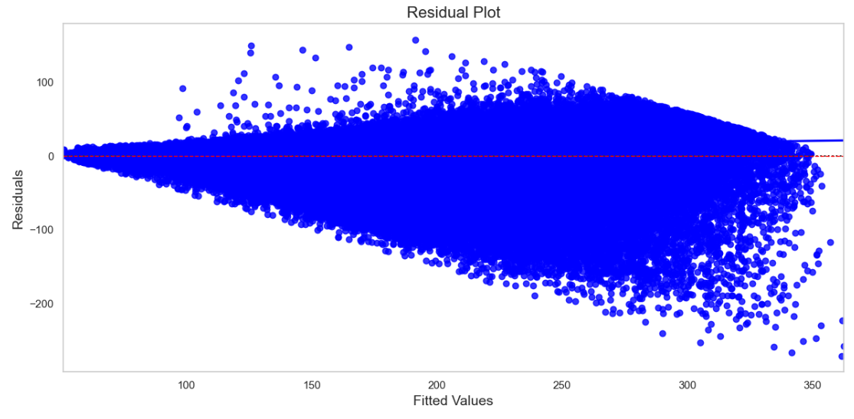
Multiple Regression Analysis

Slide 21
Multiple Regression Analysis (continued)
R-squared value of 0.750
Approximately 75% of the variability in the dependent variable (in this case, fare_low) can be explained by the independent variables included in the regression model (nsmiles, passengers, Year, fare, and fare_lg).
All P-values are 0.000
Indicates that each independent variable is statistically significant at common significance levels (e.g., 0.05).
This means there's strong evidence to reject the null hypothesis for each variable, indicating that they do contribute to the model.
Confidence Intervals:
These intervals provide a range within which we can be 95% confident that the true parameter lies.
For instance, for nsmiles, the interval is [-0.002, -0.002], suggesting strong confidence in the negative impact of miles on fares.
The model indicates:
Nsmiles and passengers are negatively correlated with fare_low
Year and fare are positively correlated.
The statistically significant results suggest that these relationships are unlikely to be due to random chance.

Slide 22
Thank You!

